Slide 1

HUMAN CAPITAL ANALYTICS
SHANMUGAN K

Slide 2
Table of Contents
Introduction
Business Problem, Business Goal, Analytical Goal
Data Understanding
Data Preprocessing
Descriptive Analytics
Hypothesis Analysis
Predictor Analysis
Modeling
Recommendation

Slide 3
Introduction
In the last decades, having the best machines was enough to be competitive or to dominate an industrial sector. Nowadays, companies with more engaged and productive employees have a better chance of winning in market competition. For this reason, companies cannot lose important employees, and when that begins to happen, you need to understand why, to prevent this from happening.

Slide 4

Business Problem ?
Employee Leaving the Organization

Slide 5

Business Goal
Retain Employees

Slide 6
Analytical Goals
Classify employees based on turnover
Find important factors contributing to employee turnover

Slide 7
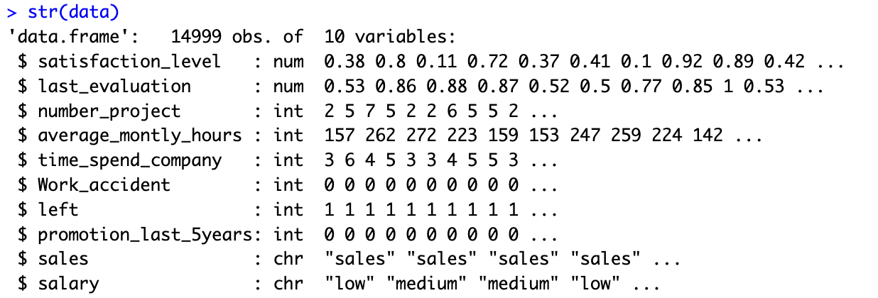
Data Understanding

Slide 8
Attribute Definition
Column Name | Description
'satisfaction_level' | The employee's level of job satisfaction typically ranges from 0 to 1, where 1 indicates high satisfaction.
'last_evaluation' | The employee's most recent performance evaluation score usually ranges from 0 to 1.
'number_project' | The number of projects the employee was involved in during their tenure.
'average_montly_hours' | The average number of hours worked per month by the employee.
'time_spend_company' | The number of years the employee has been with the company.
'work_accident' | Indicates whether the employee has had a work-related accident (1 if yes, 0 if no).
'left' | Indicates whether the employee has left the company (1 if yes, 0 if no)
'promotion_last_5years' | Indicates whether the employee was promoted in the last five years (1 if yes, 0 if no)
'department' | The department field is a department in which the employee works, such as "sales," "technical," "support," etc.
'salary' | The salary level of the employee is typically categorized as "low," "medium," or "high."

Slide 9
Data Preprocessing
Check for Null Values
Check for Zeroes
Data Manipulation

Slide 10
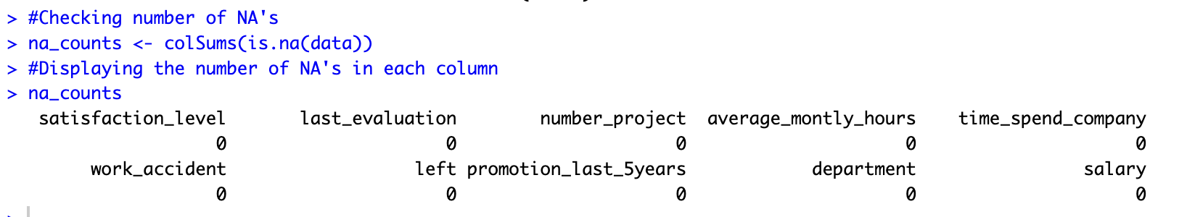
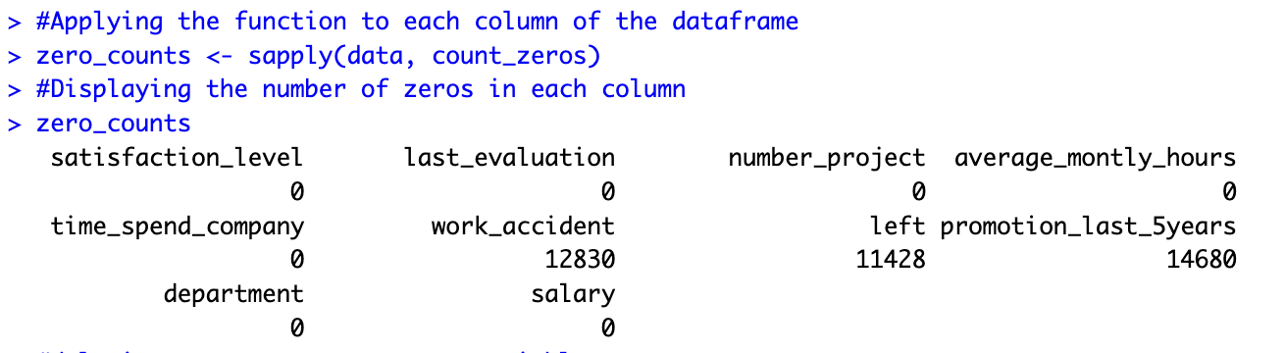
Check for Null and Zeroes

Slide 11
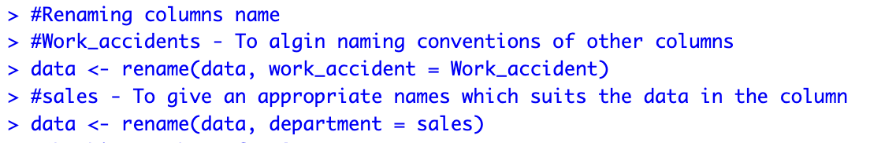
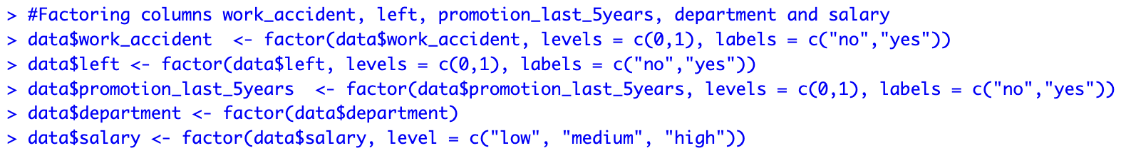
Data Manipulation

Slide 12
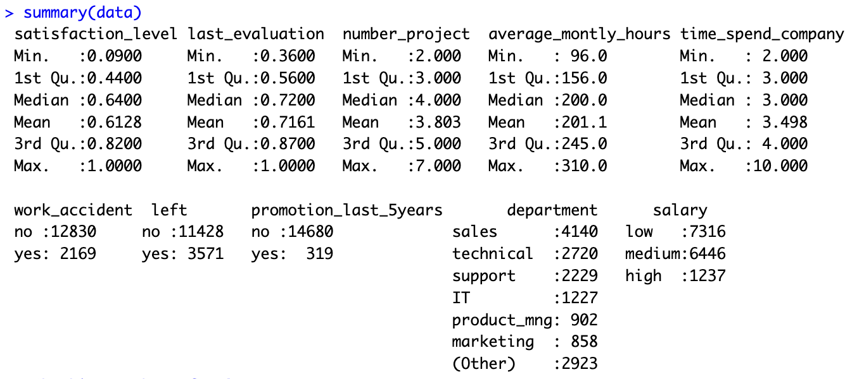
Descriptive Analytics

Slide 13
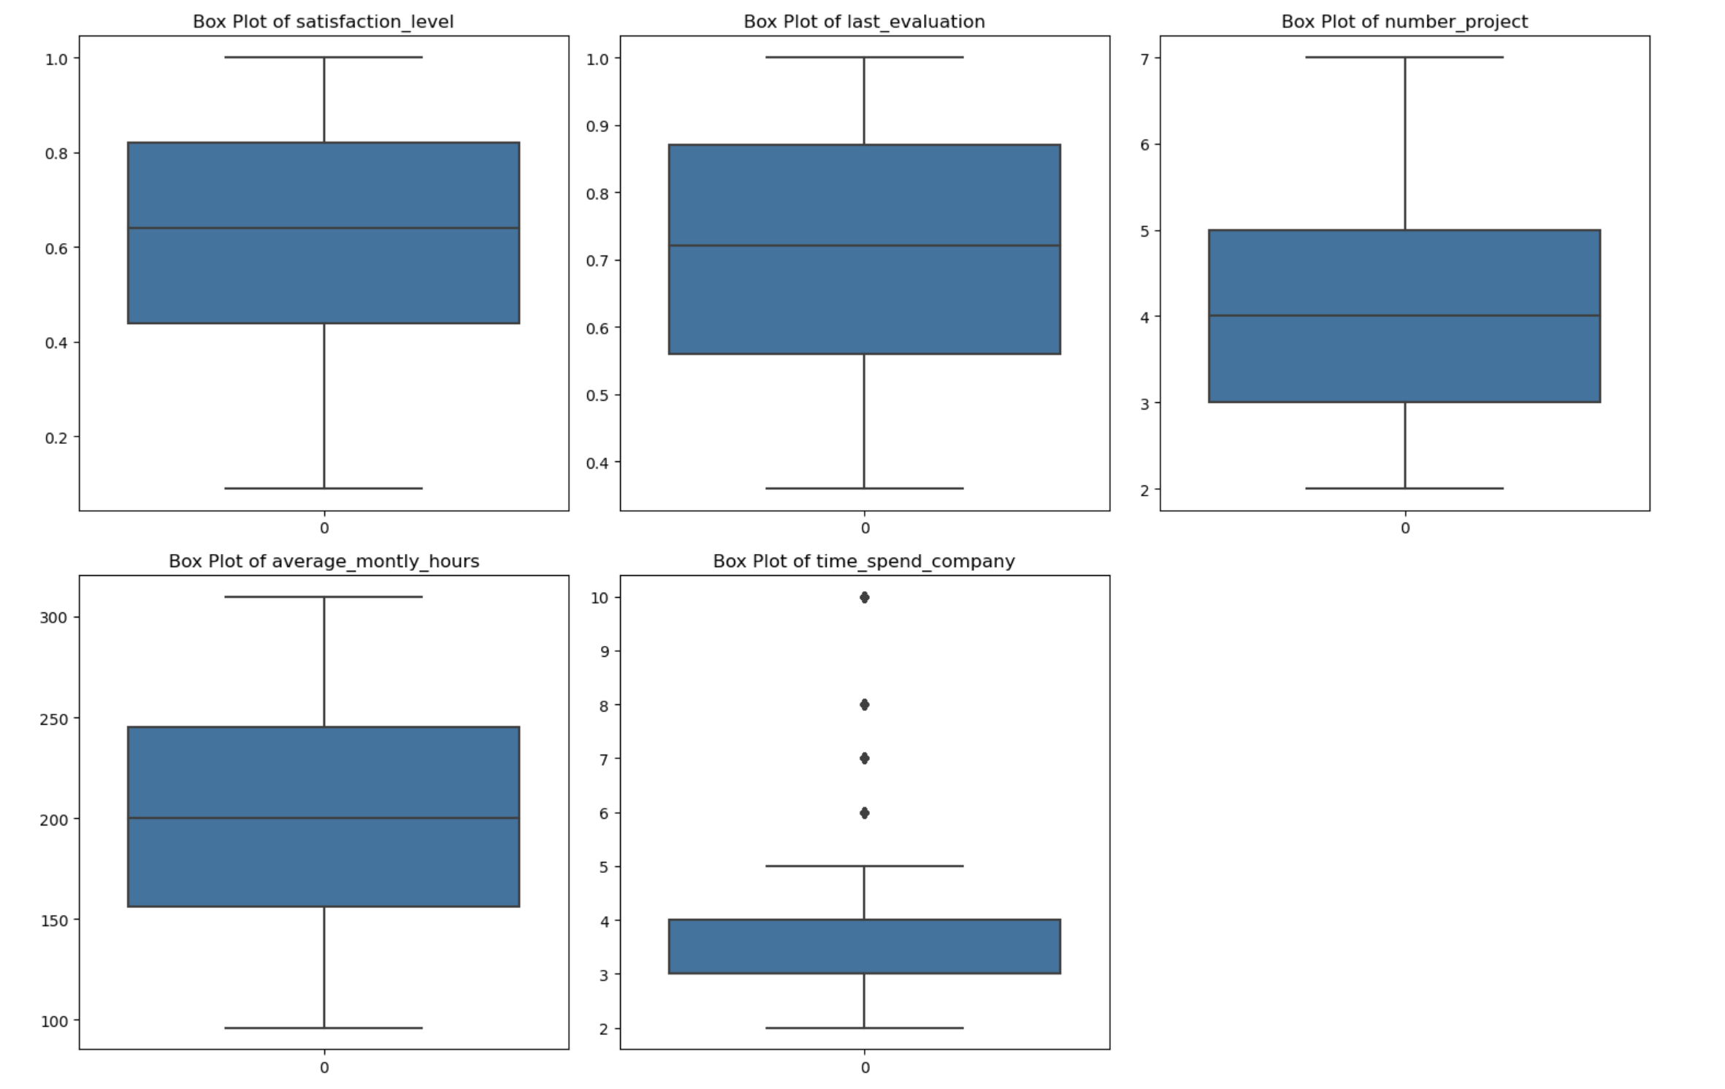
Descriptive Analytics

Slide 14
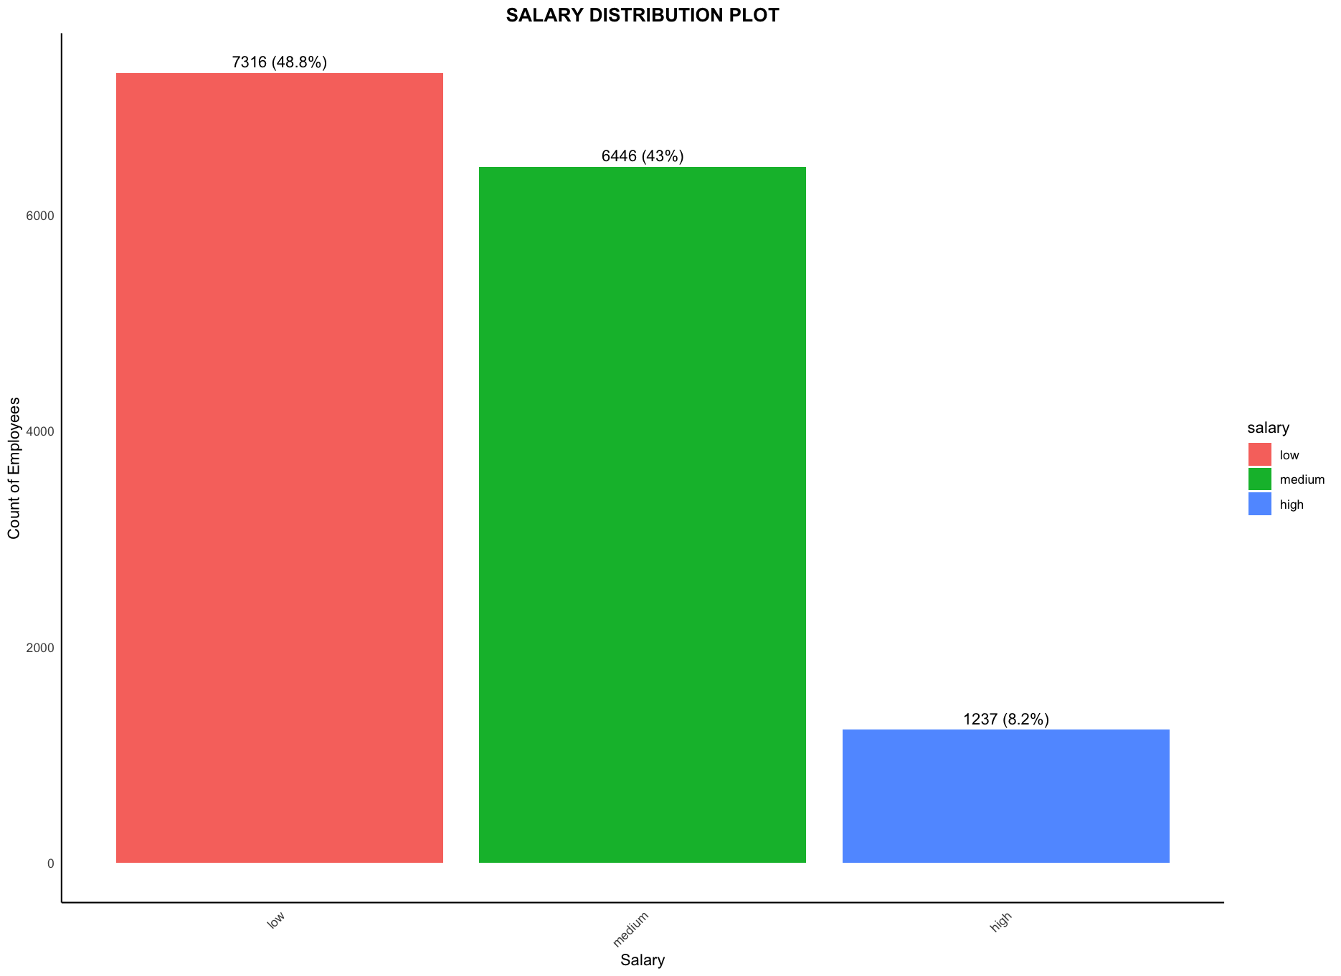
Descriptive Analytics

Slide 15
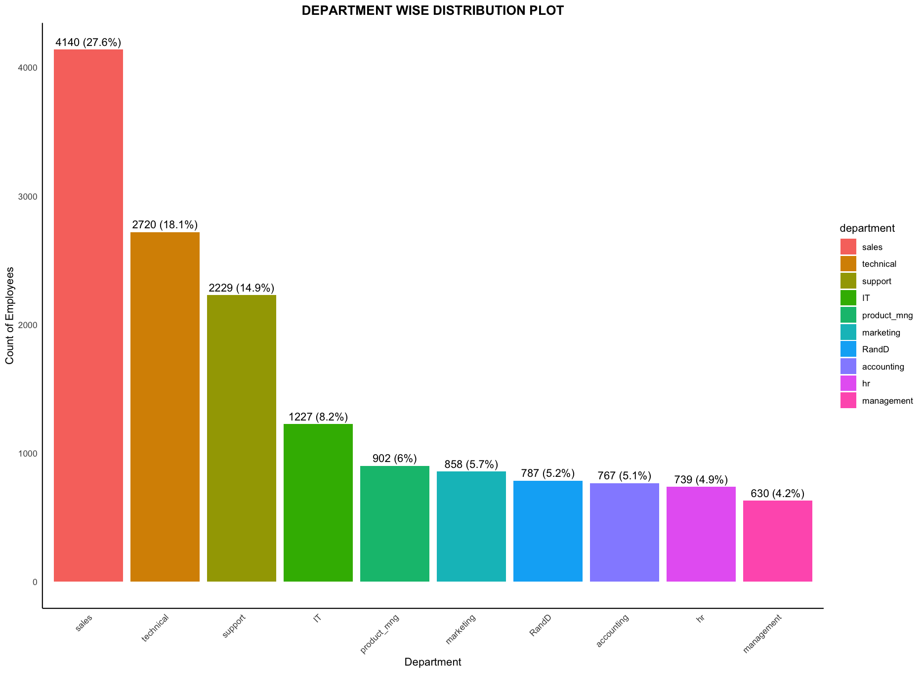
Descriptive Analytics

Slide 16
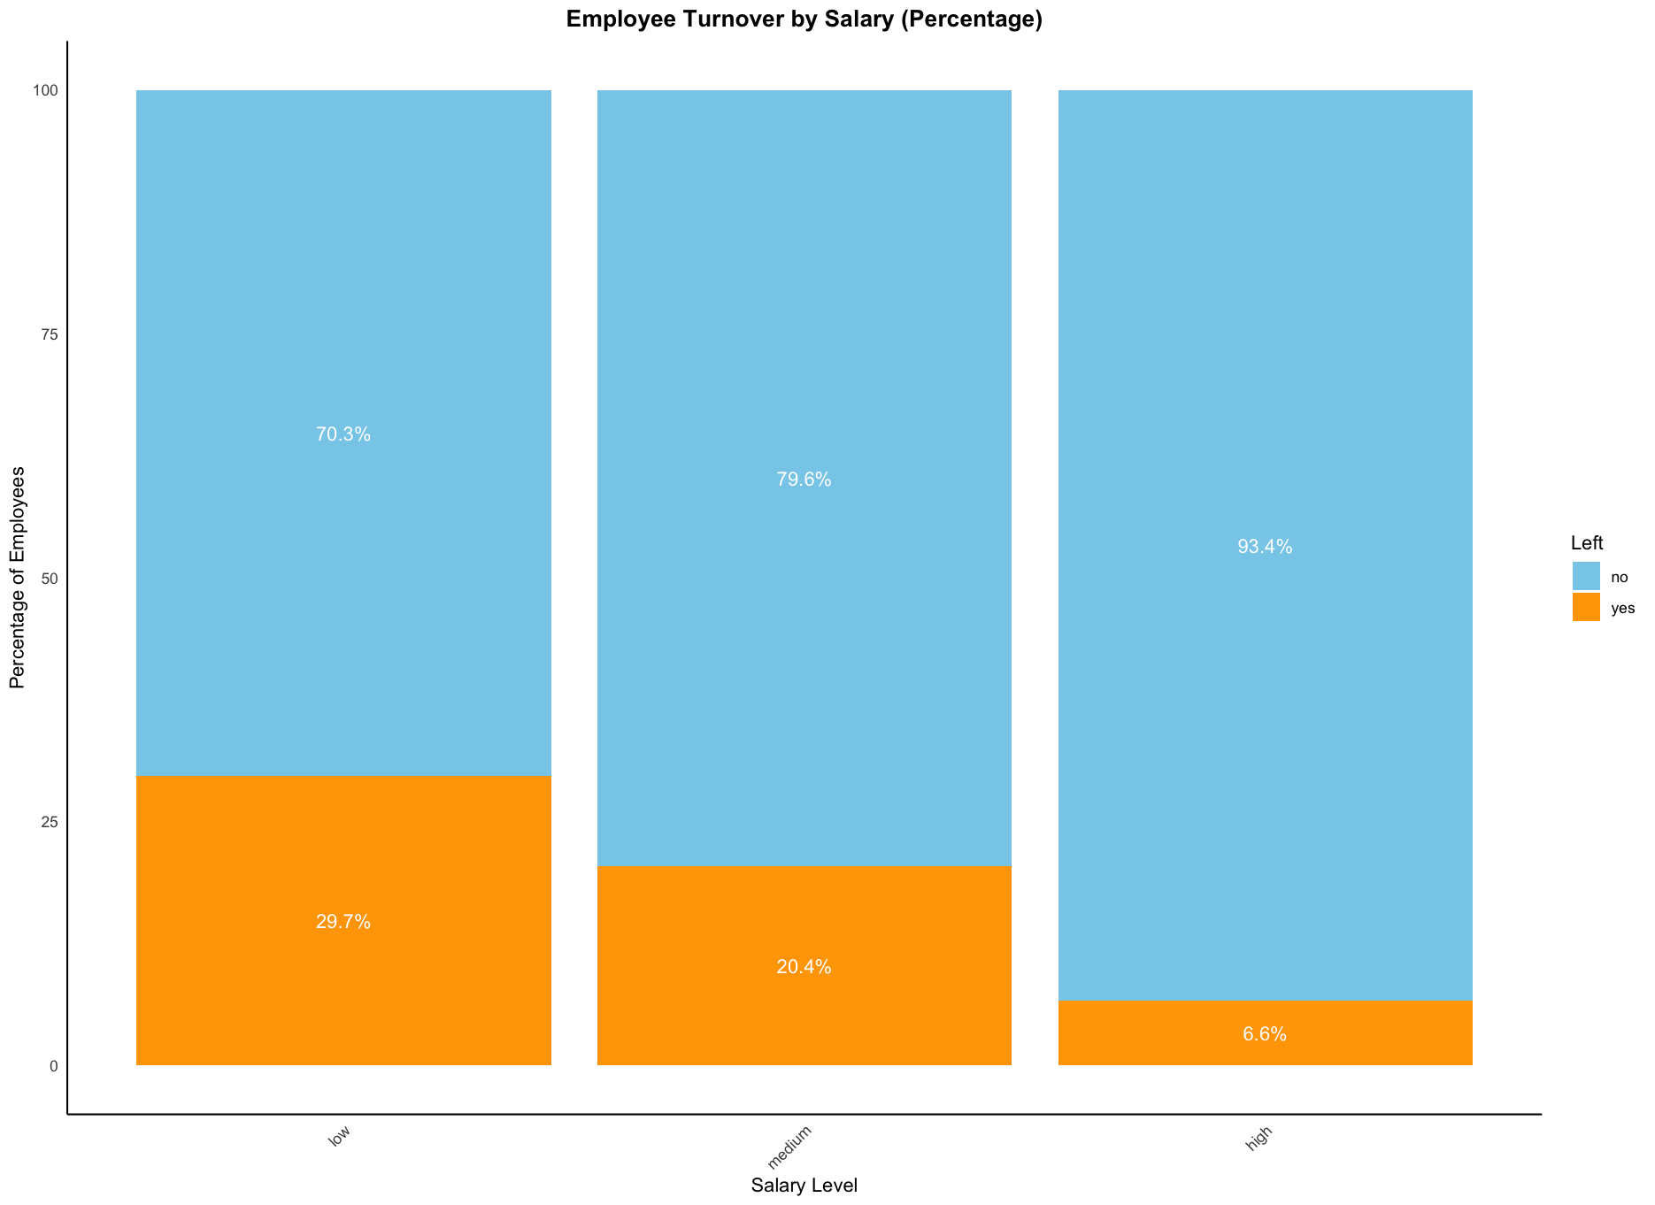
Hypothesis 1 Is salary reason why the employees left the company?

Slide 17
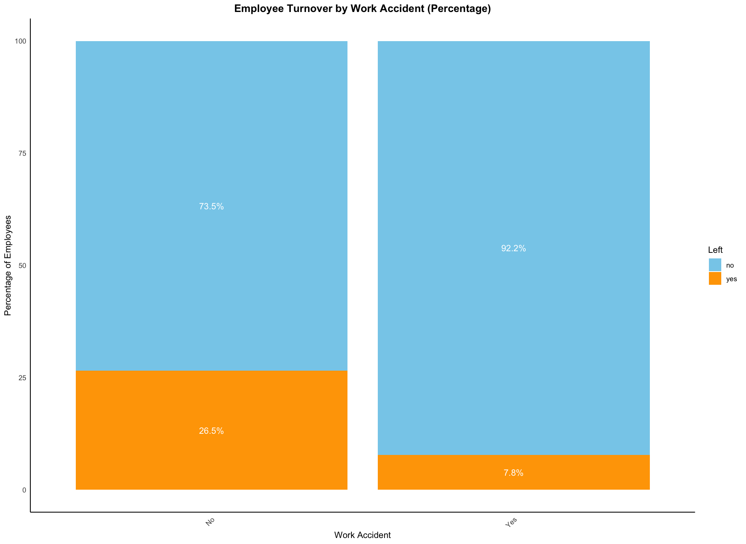
Hypothesis 2 Is employees leaving the company because work is not safe?

Slide 18
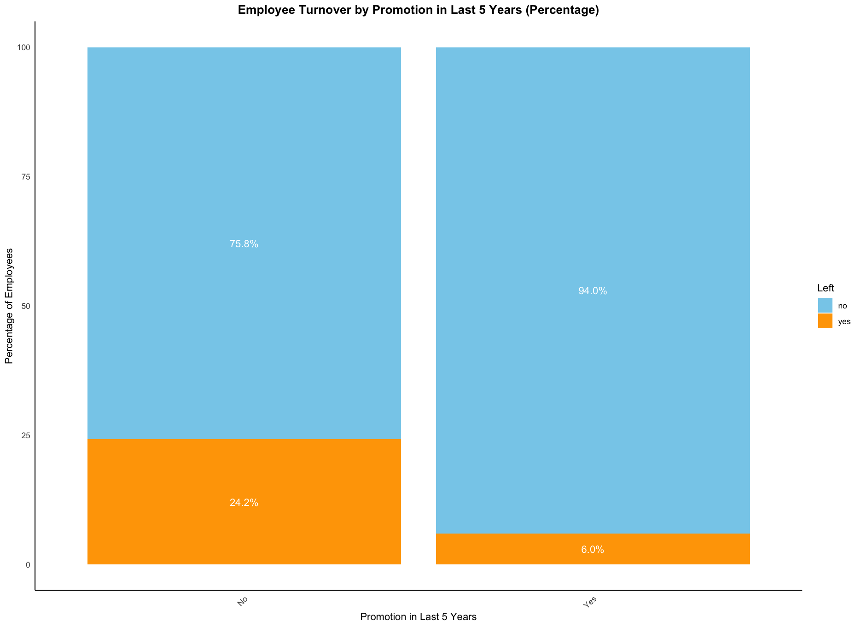
Hypothesis 3 Is this company a good place to grow professionally?

Slide 19
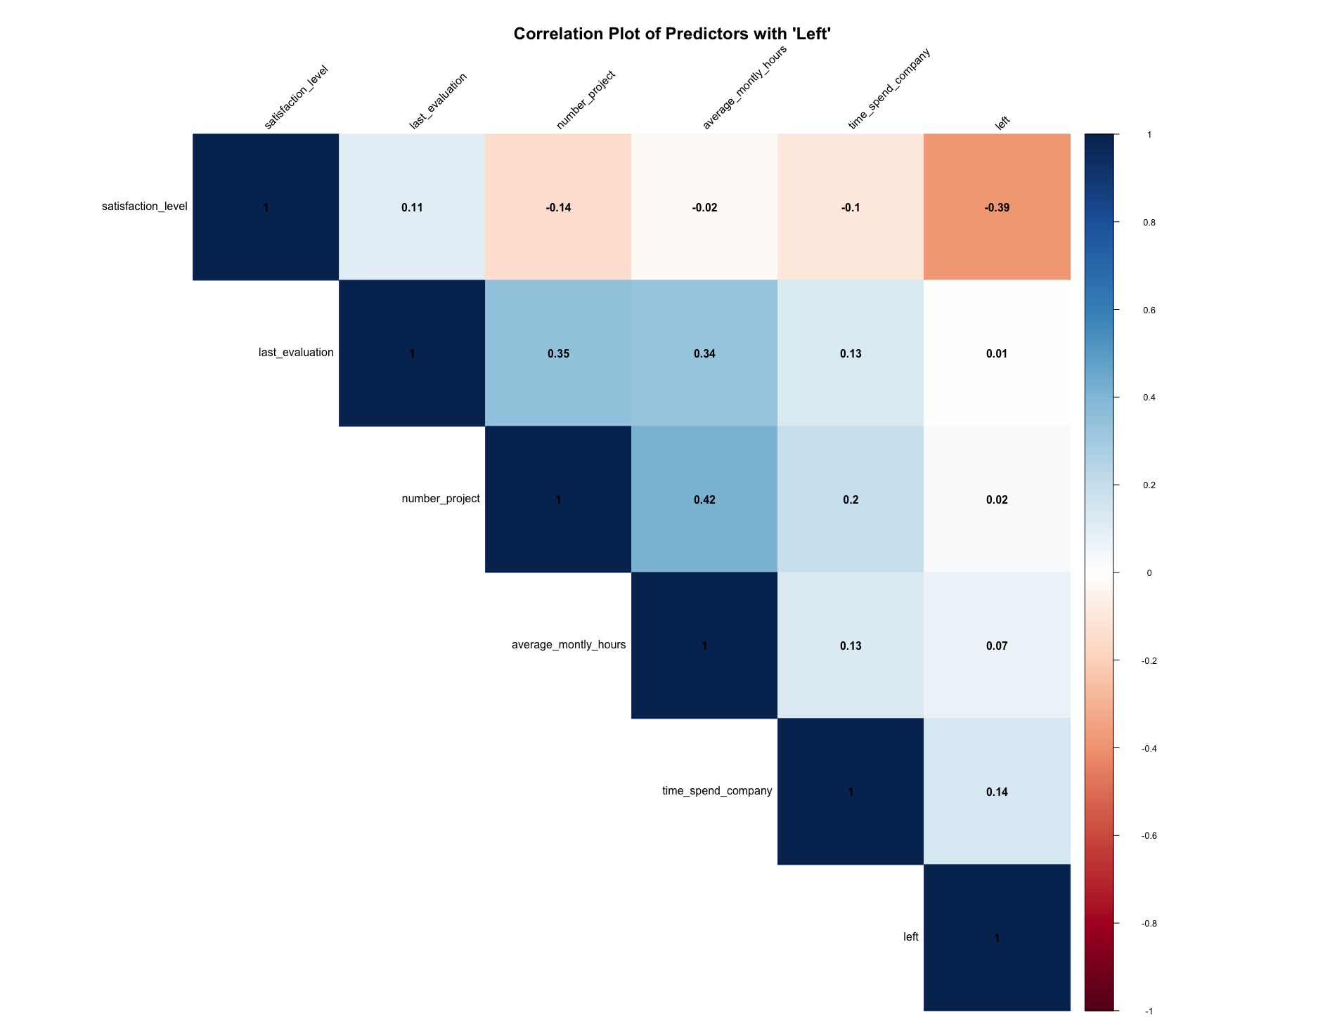
Predictor Analysis

Slide 20
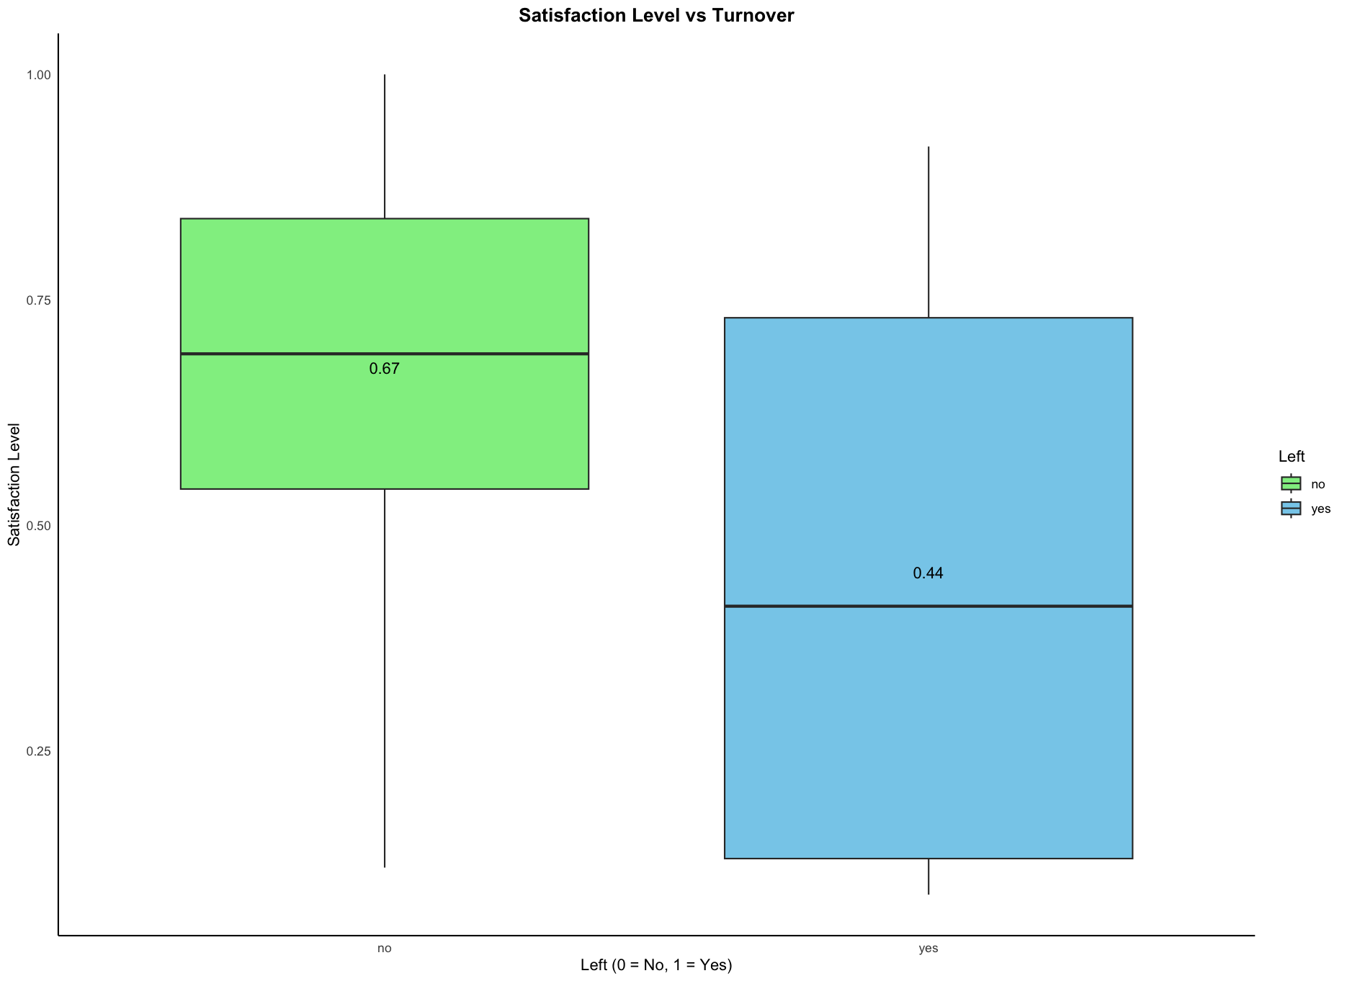
Predictor Analysis

Slide 21
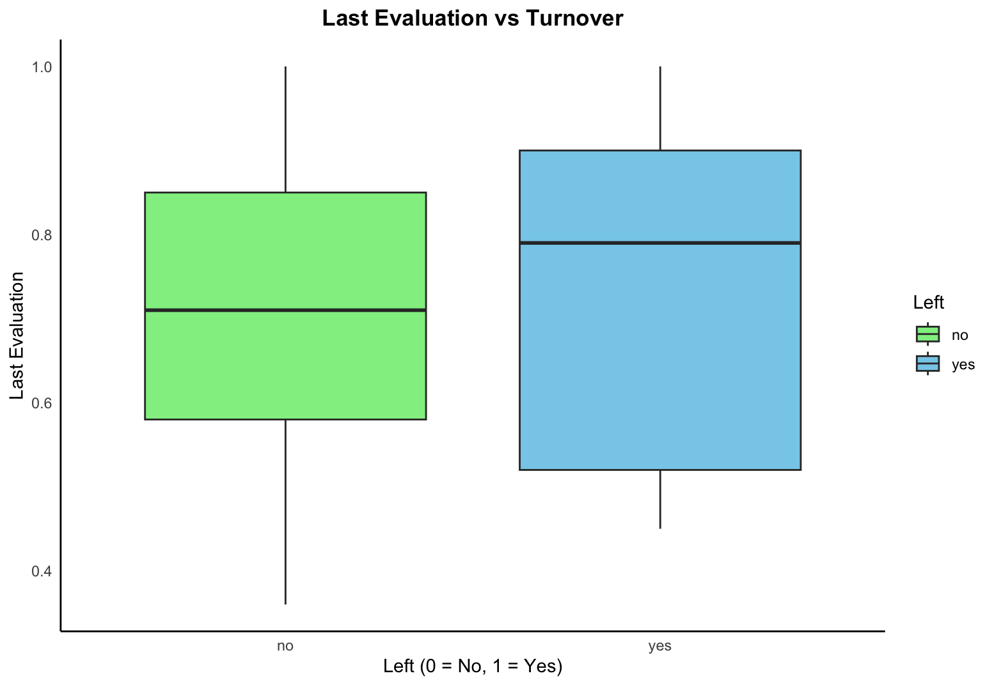
Predictor Analysis

Slide 22
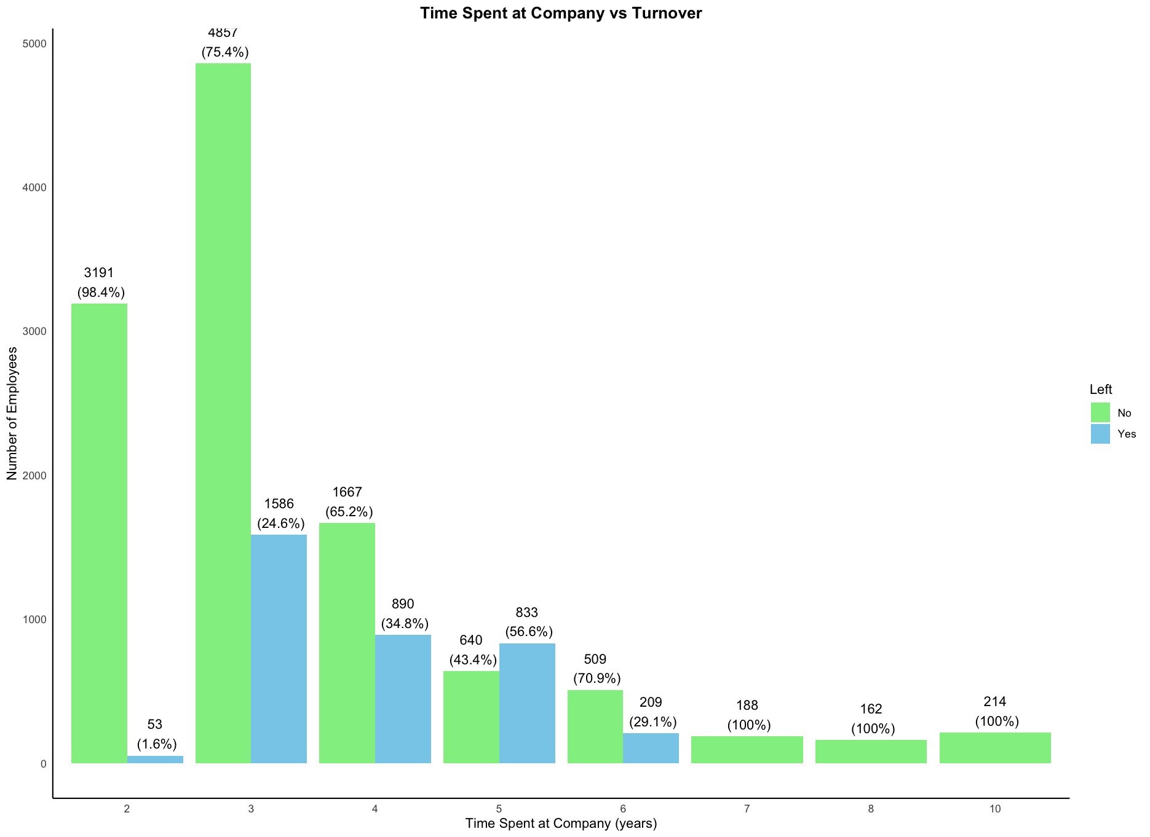
Predictor Analysis

Slide 23
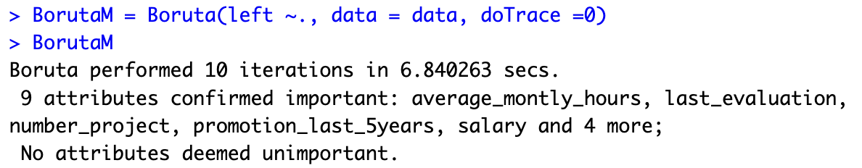
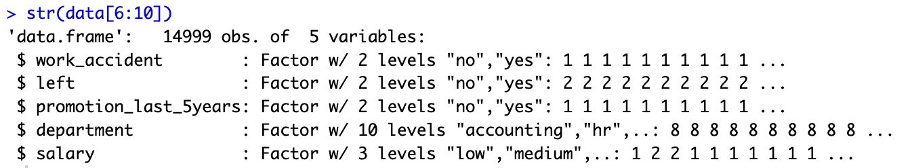
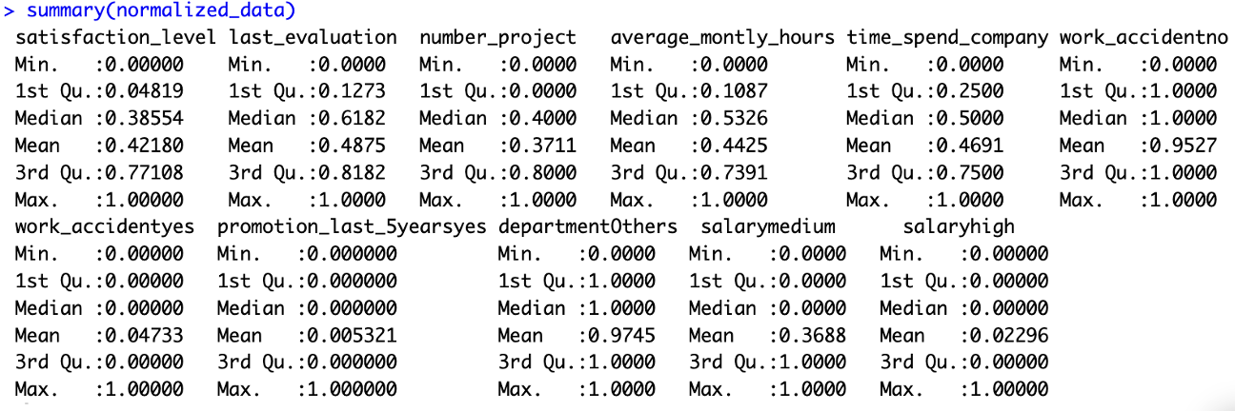
Dimension Reduction and Data Transformation

Slide 24
Modeling
Data Partitioning
Model Selection
Model Building
Model Testing
Model Evaluation
Model Improvement
Picking the best performing Model
Run the model on validation data

Slide 25
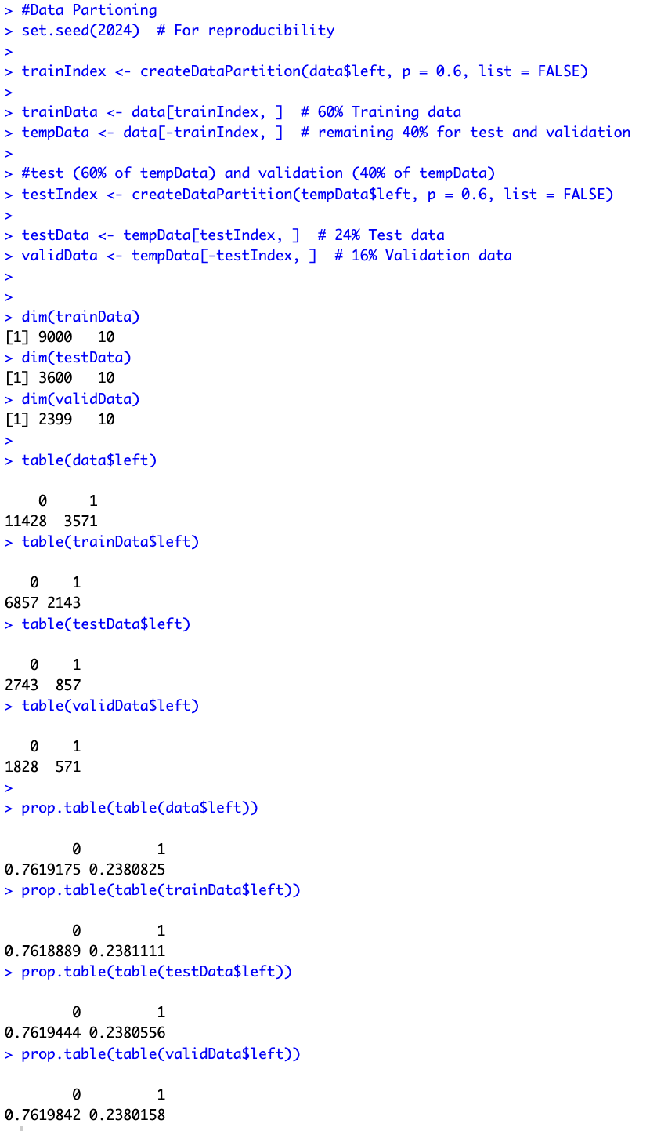
Data Partitioning

Slide 26
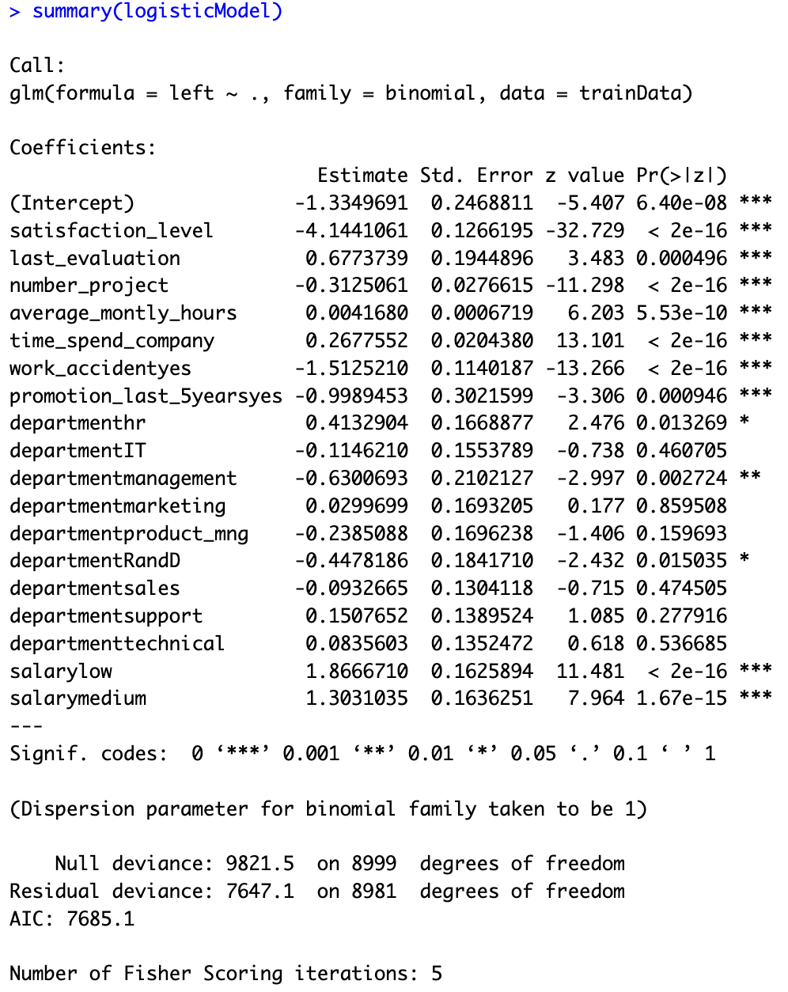
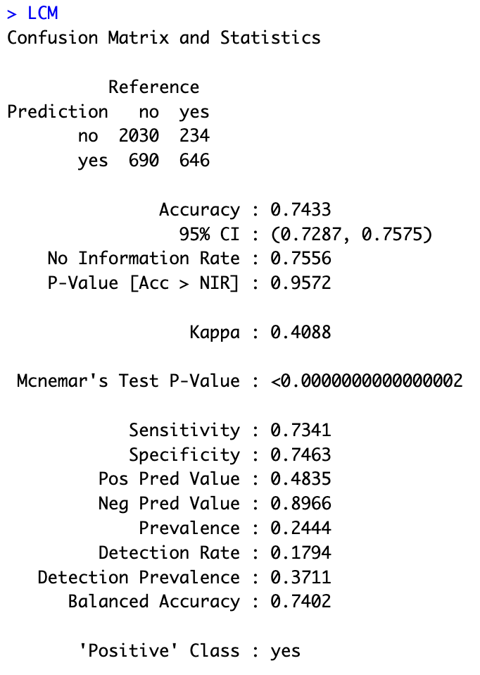
Logistic Regression Model

Slide 27
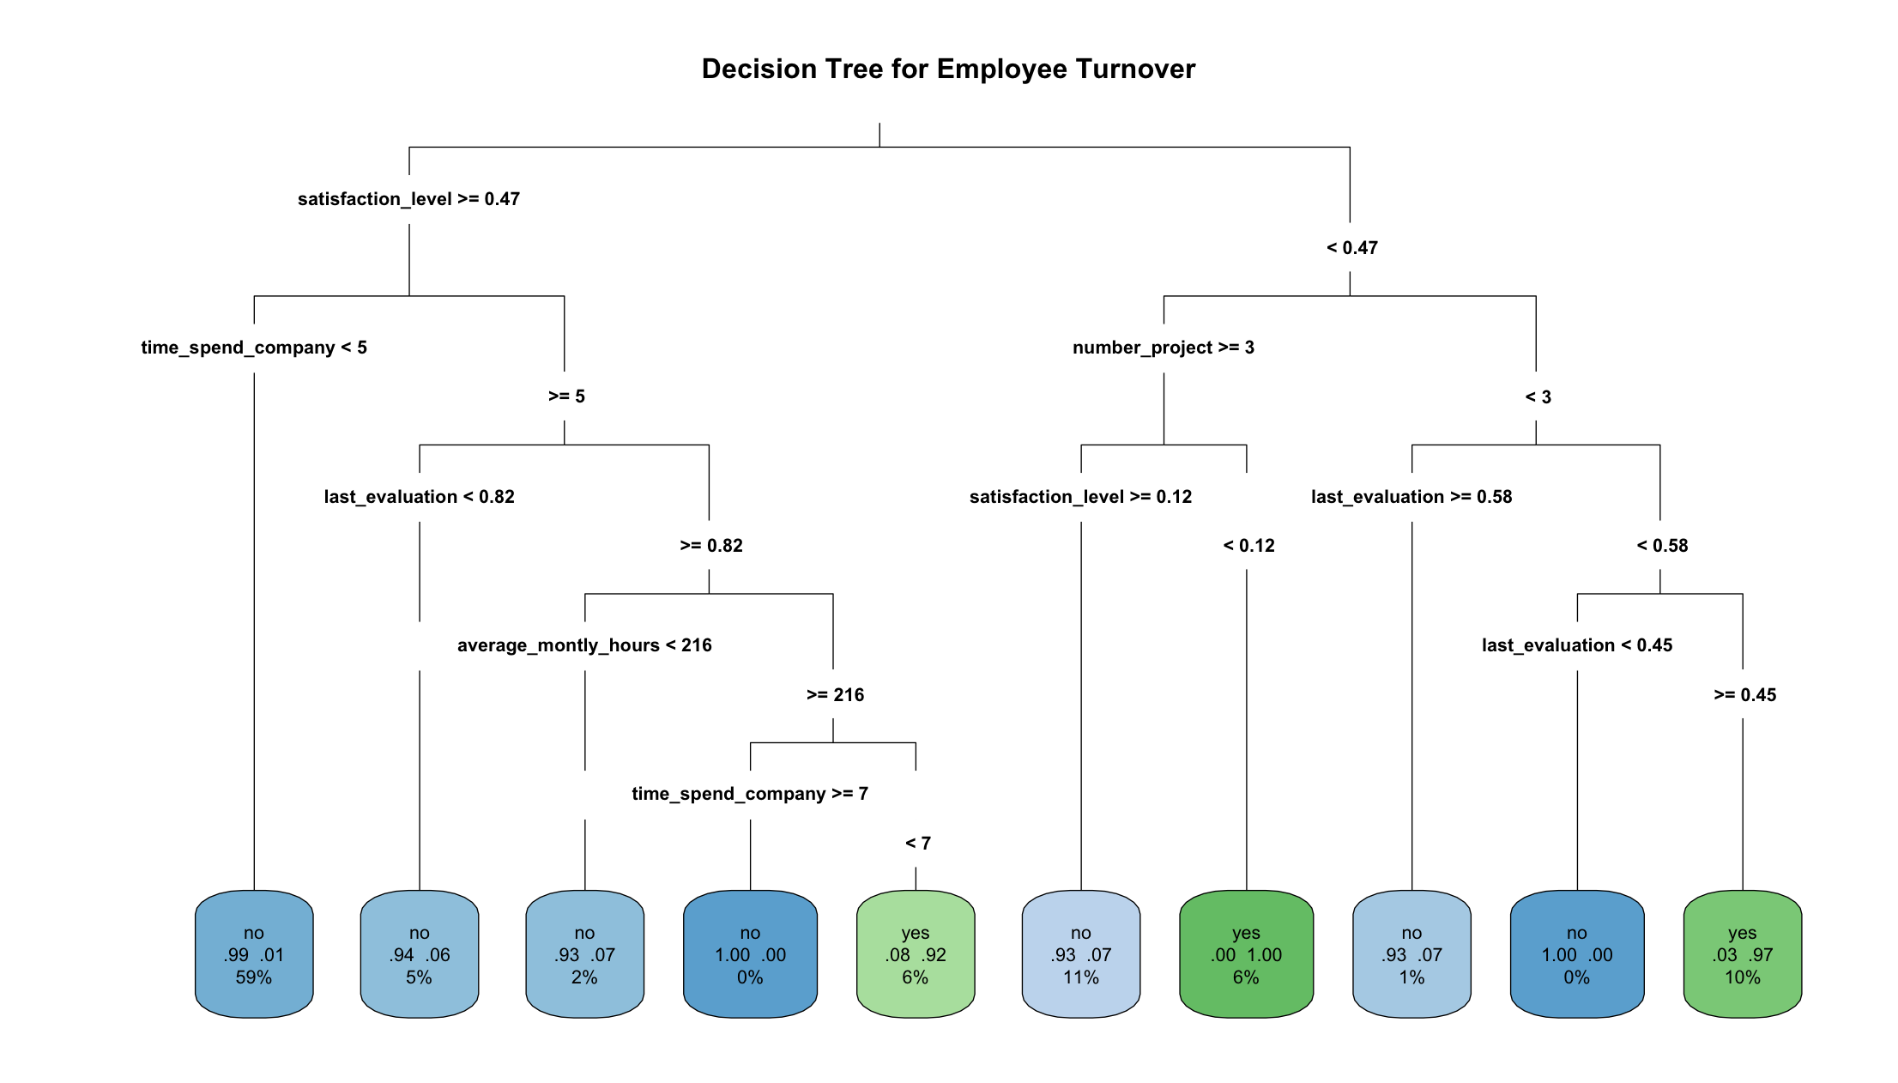
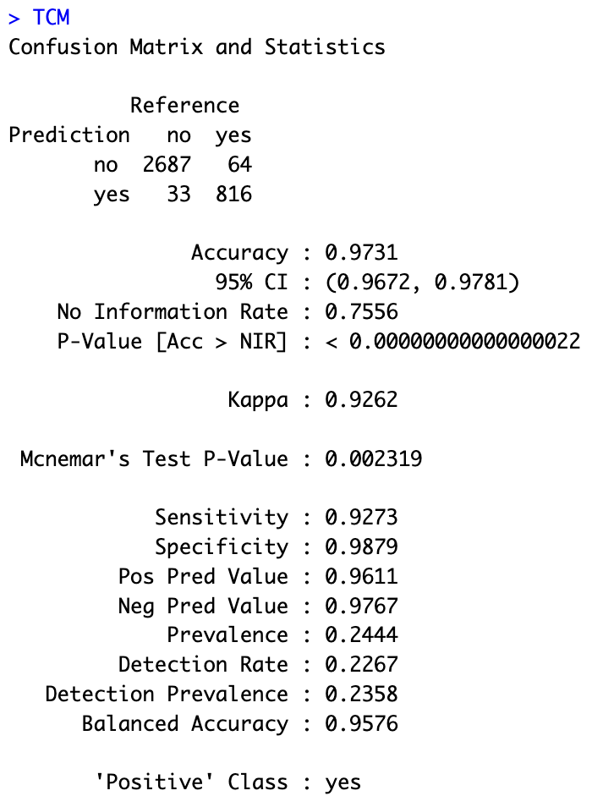
Classification Tree Model

Slide 28
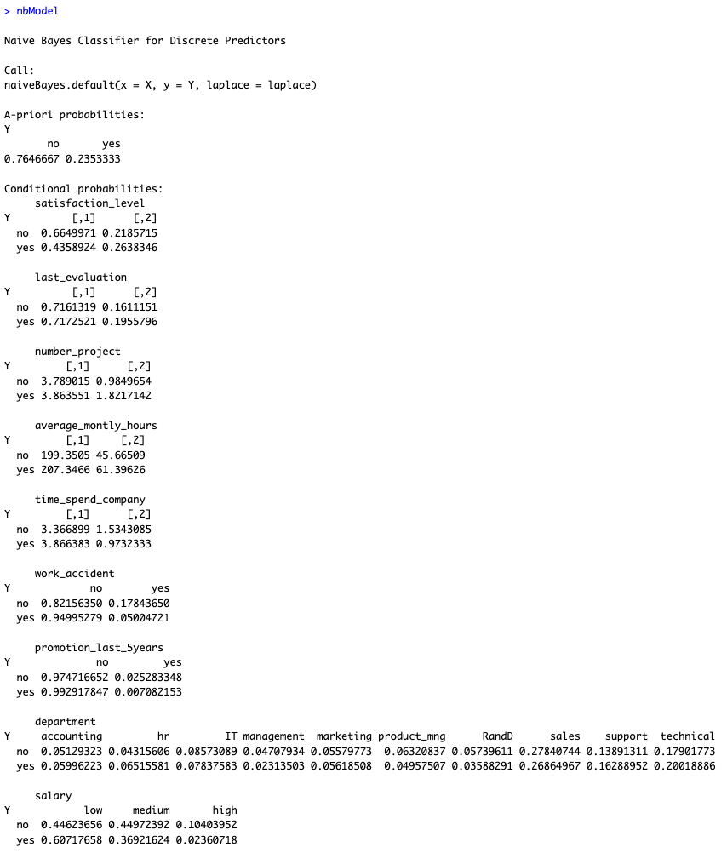
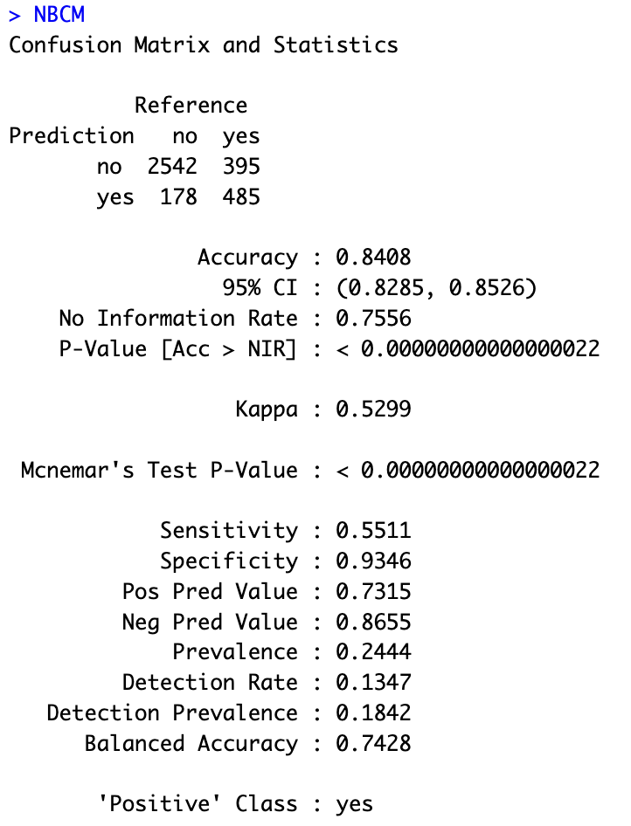
Naïve Bayes Model

Slide 29
Model Selection and Evaluation
Model Name | Accuracy | Sensitivity (TPR)
Logistic Regression | 74.33% | 73.41%
Classification Tree | 97.31% | 92.73%
Naïve Bayes | 84.08% | 55.11%

Slide 30
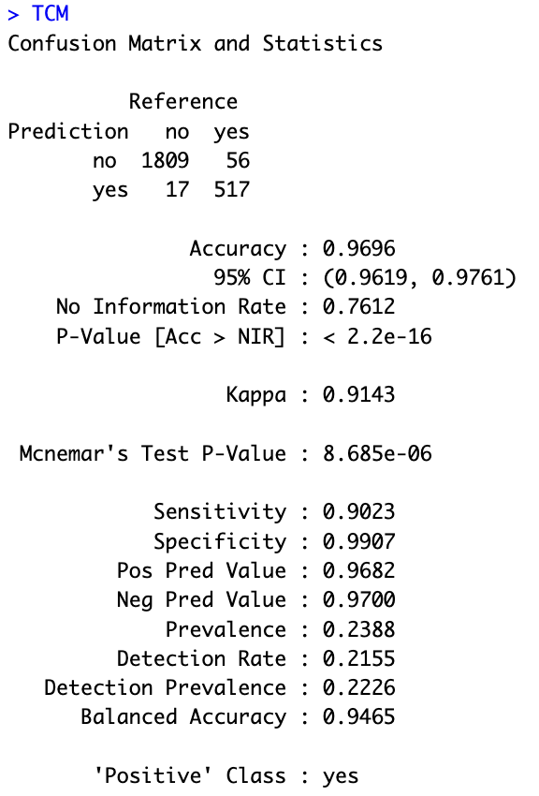
Performance Evaluation on Validation data

Slide 31
K-Means Clustering
Data Preparation : Filter the data, Remove left column and categorical columns, normalize the data
Building the model results in k number of clusters
Evaluate the model based on the silhouette
Plot the profile plot to look at the high contributing factors in the cluster with best silhouette value.
Find the best K-Means parameter by performing Tunning.
Best K-Means parameter(4) is selected based on average_silhoutte value.

Slide 32
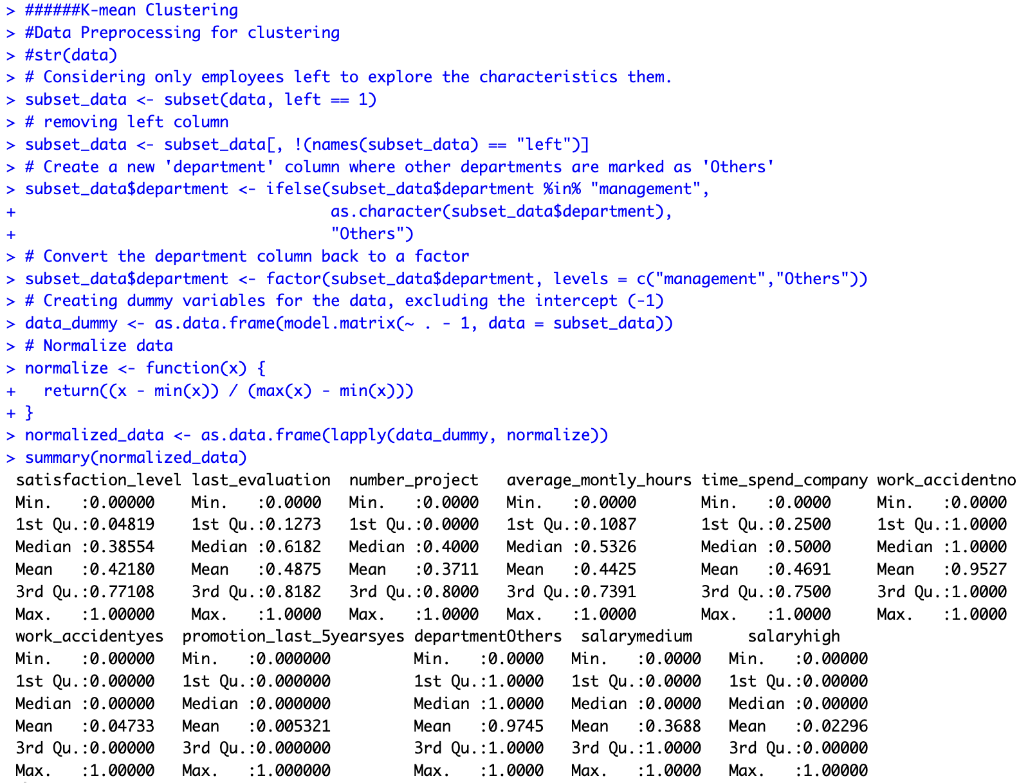
K-Means Clustering – Data Preparation

Slide 33
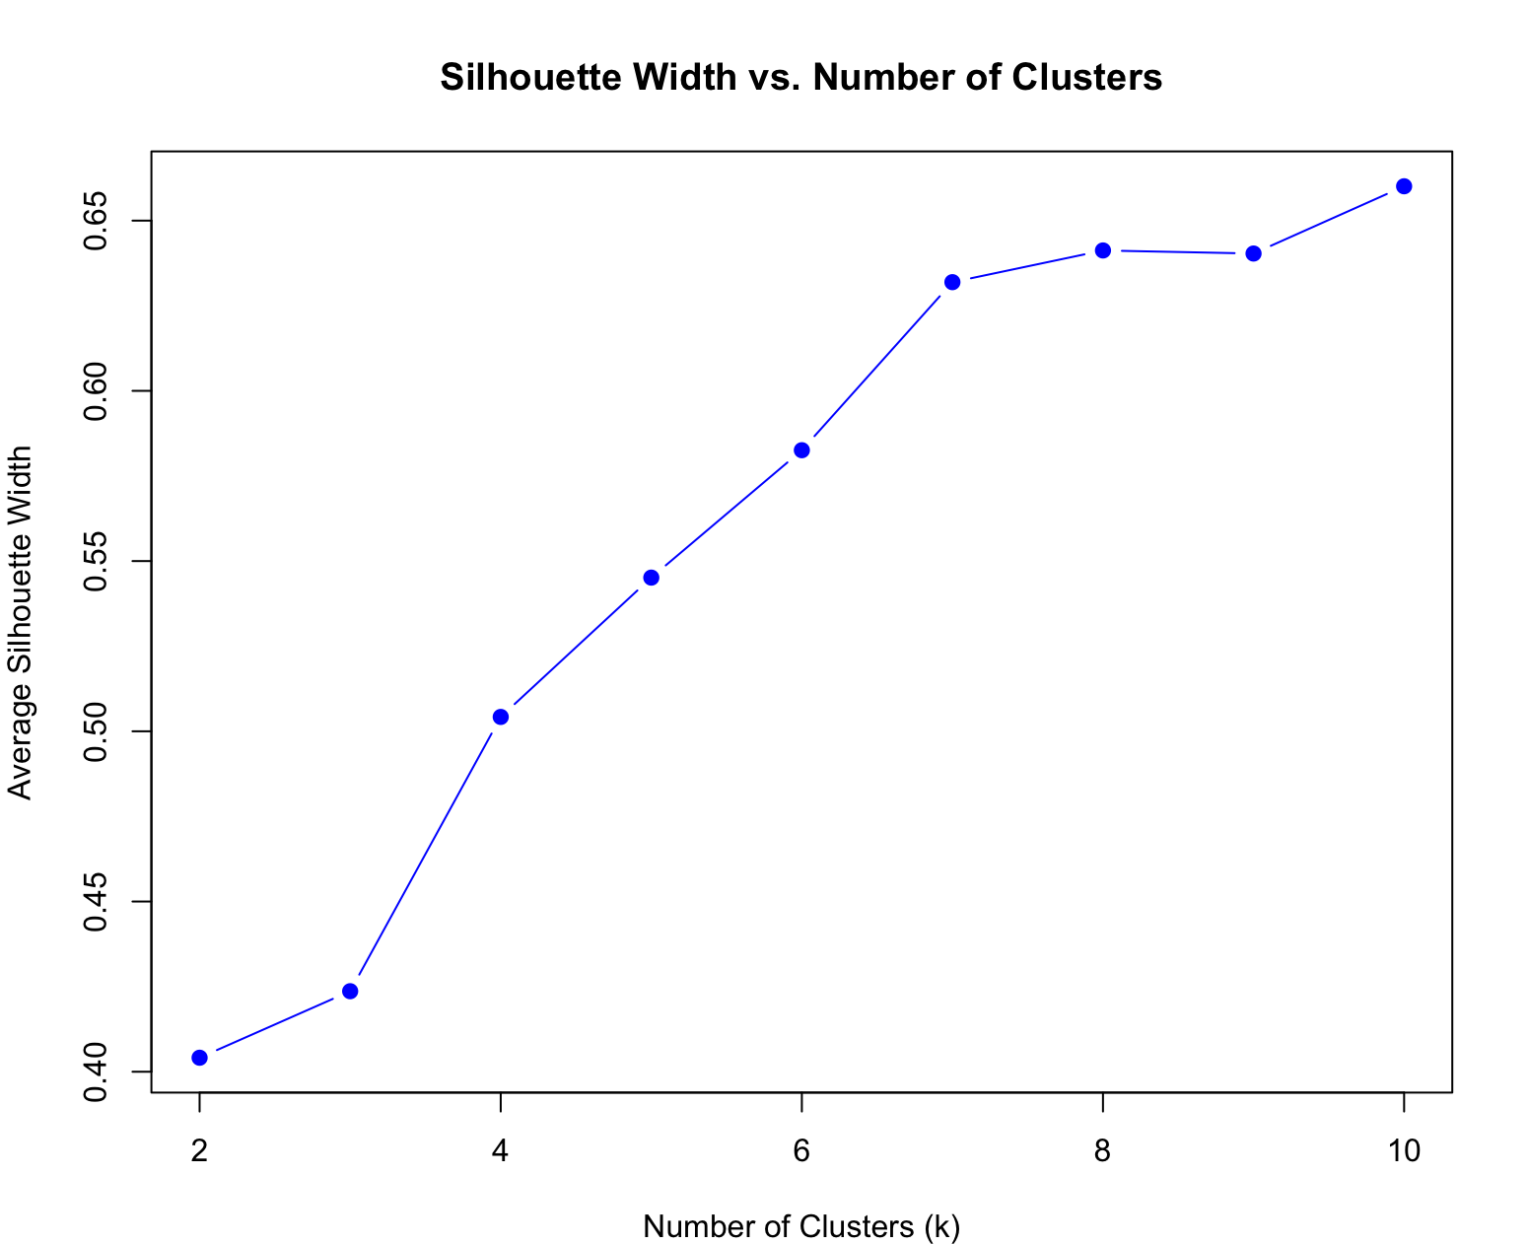
K-Means Clustering – Parameter tunning

Slide 34
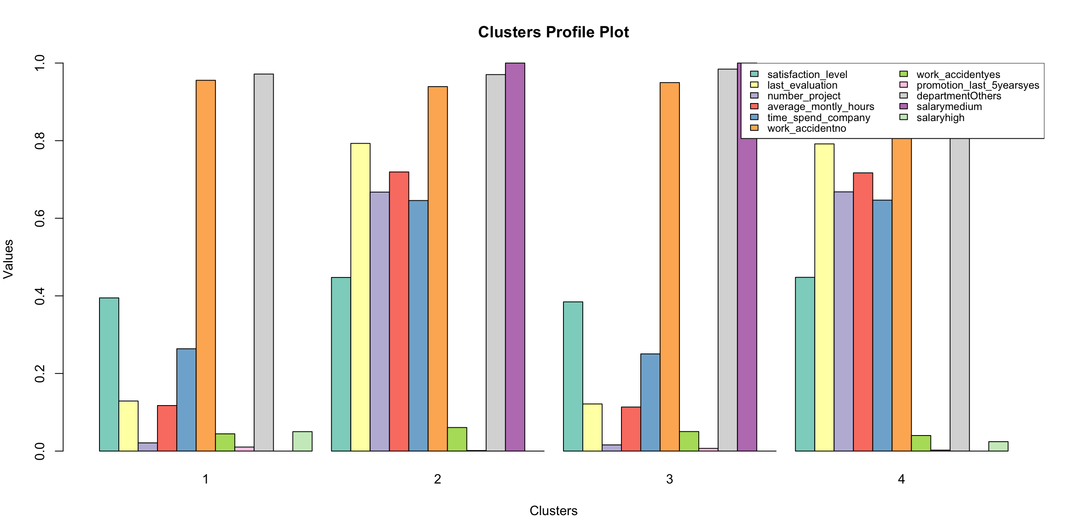
K-Means Clustering – Modeling

Slide 35
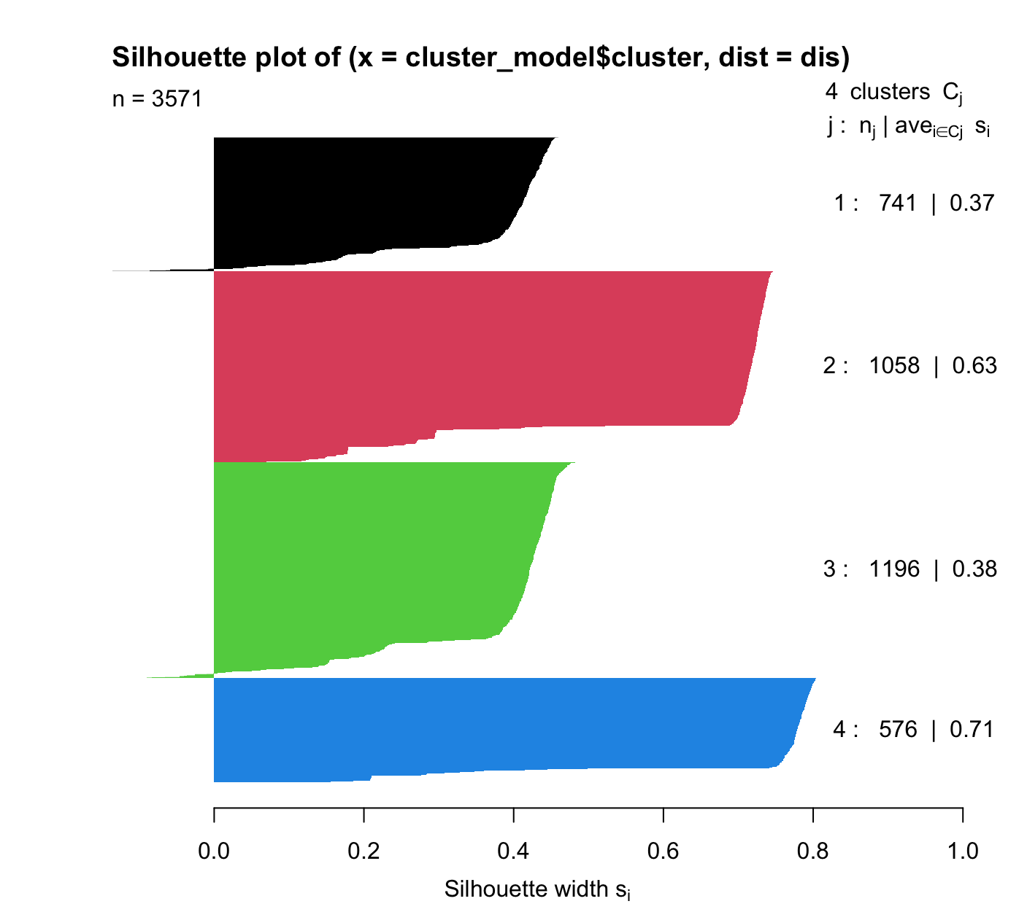
K-Means Clustering – Cluster comparison

Slide 36
K-Means Clustering – Profile Plot
Engaged but Unrewarded: These employees are moderately satisfied, have decent performance evaluations, and work long hours, but have limited opportunities for promotions. They have medium salaries and tend to stay longer with the company.
Disengaged and Underperforming: This group is characterized by low satisfaction, poor performance evaluations, minimal project involvement, and very few work hours. They also have a short tenure and are less likely to receive promotions or experience work accidents.
High Potential but Unrecognized: These employees exhibit similar satisfaction and evaluation levels to the first group, but they spend longer with the company and work more hours. However, they are rarely promoted, indicating untapped potential. They also have low work accident rates and are primarily in medium salary brackets.
Frustrated and Stagnant: Employees in this group have low satisfaction, poor evaluations, minimal involvement, and very low hours. Despite being more likely to experience promotions, they are likely frustrated and stagnant in their roles. They tend to have higher salaries but shorter tenure.

Slide 37

Conclusion
Classification tree has been performing best model among other models to predict employee turnover which solved analytical goal one with an accuracy and sensitivity of 96.96% and 90.23%.
K-Means clustering highlighted key factors contributing to employee turnover, helping to uncover patterns within different groups of employees .

Slide 38

Recommendations
Regular audit.
Monitoring of the models.
Ensuring long-term relevance and effectiveness.
Implement targeted actions on the employees classified as turnover from predictive models.

Slide 39
Recommendations
Get the list of employees prone to turnover using a classification tree model.
Conduct drives to increase the employee satisfaction level
Introduce schemes for employees’ milestones in the long run at the organization, which might boost employees’ interest in staying with the company.
Clearly convey employees' targets and goals at the beginning of the year or quarter, so they can improve their evaluation scores.
Offload employees' burden with high working hours and several projects.

Slide 40

Q & A

